Slide 1
Brazil IPS premisses
Data currently available on RNDS will be used to generate the first version of Brazil IPS
More than 1.2 billion immunization records of 103 different vaccines ( at least 4 of them do not exist on SNOMED core…)
More than 800.000 Lab reports of COVID-19 and Monkeypox exams
It is expected that till October we will also have allergies and medications from eSUS-AB the Brazilian primary care information system used in 82% of our primary care units

Slide 2
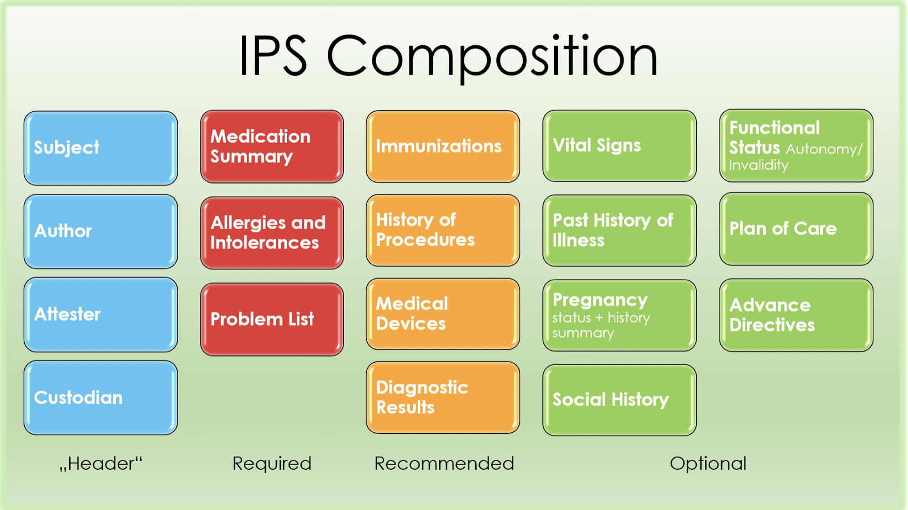
http://hl7.org/fhir/uv/ips/

Slide 3
Current Status IPS-Brasil
80% of the Brazilian RNDS CodeSystems, ValueSets and ConceptMaps of Immunization(IPS), Diagnostic Report(IPS), Allergy Intolerance(IPS), and Medication (IPS) loaded in OCL terminology server;
20% of the FHIR IPS profiles in FHIRSH for those sections that will be in the first version of the Brazilian IPS (Immunization(IPS), Diagnostic Report(IPS), Allergy Intolerance(IPS), and Medication (IPS)

